Slide 1

FloraGuard AI
Intelligent Mobile Application for Plant Disease Detection & Care
Abhiroop Sourav
Sohin Abhiram
Project Guide: Jinsha k

Slide 2
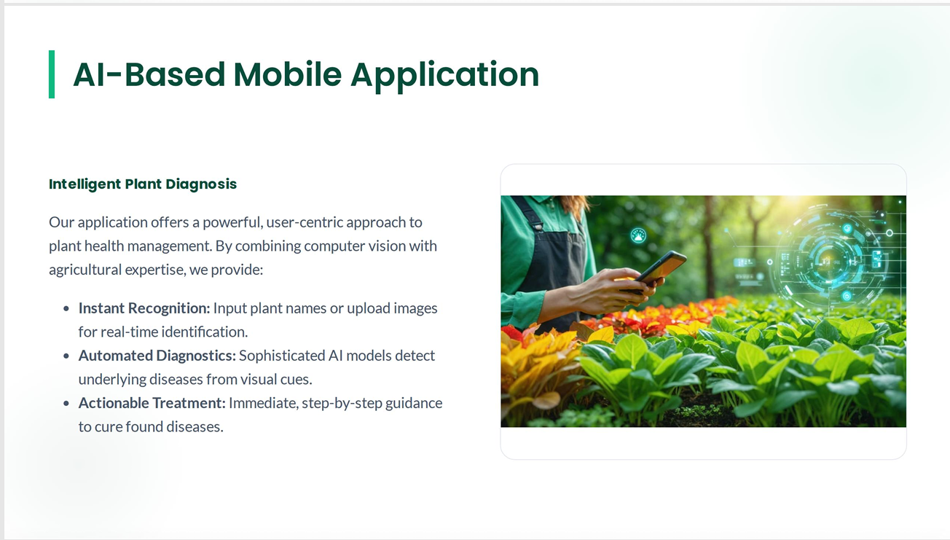

Slide 3






Plant Care Recommendations
Soil Composition
Watering Logic
Light Exposure
Nutrient Guide
Specific soil types and pH requirements for optimal growth and root health.
Precise hydration intervals and volume based on plant stage and species.
Sunlight intensity and duration needed (Full Sun vs. Partial Shade).
Recommended fertilizer types (Organic/Synthetic) and application timing.

Slide 4
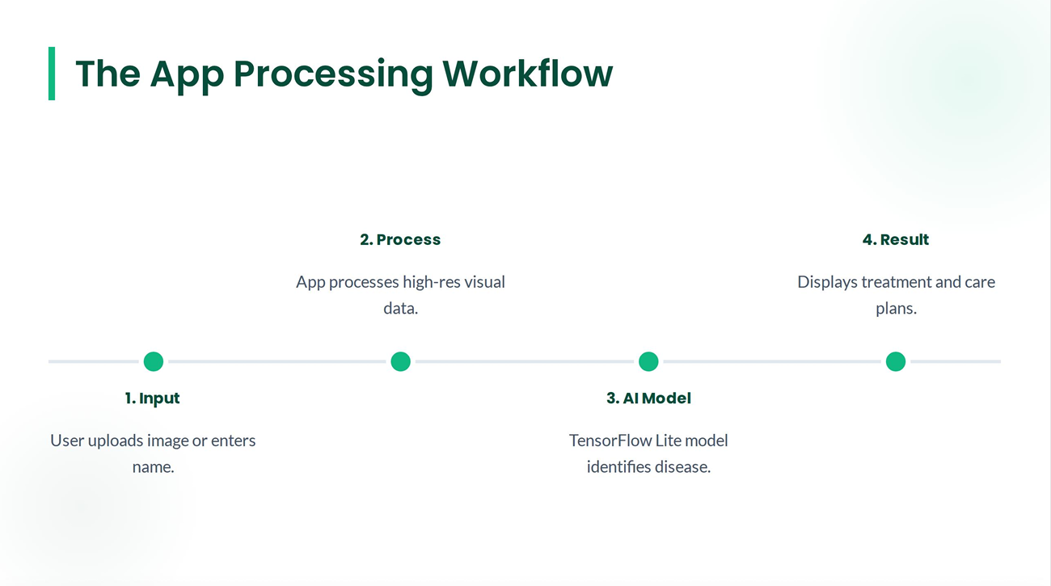

Slide 5
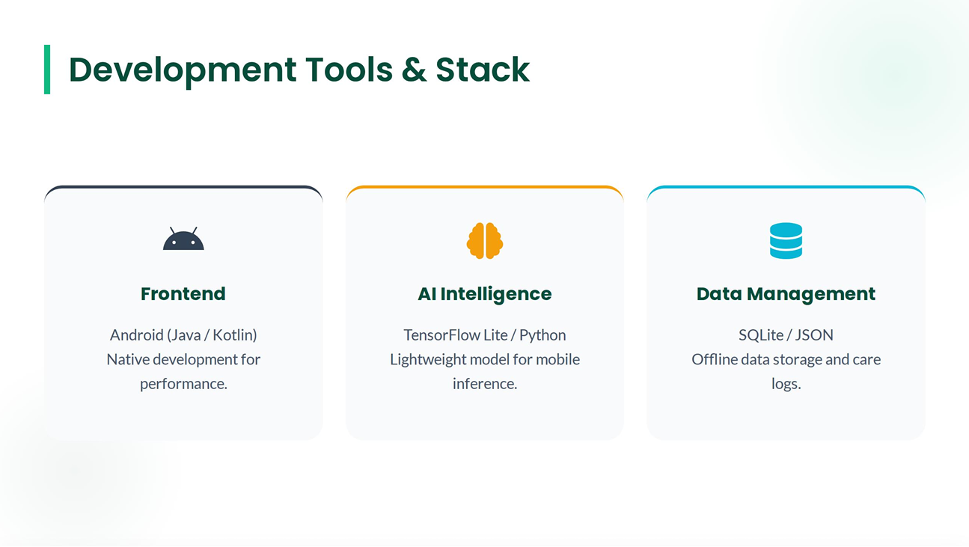

Slide 6
Key Project Benefit
100%
Offline Capability
Core AI diagnostic features work without internet connection

Slide 7
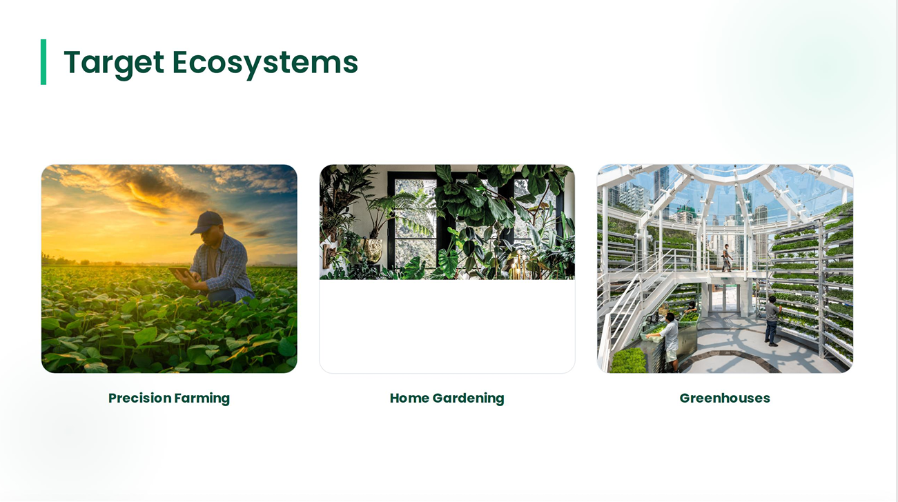

Slide 8
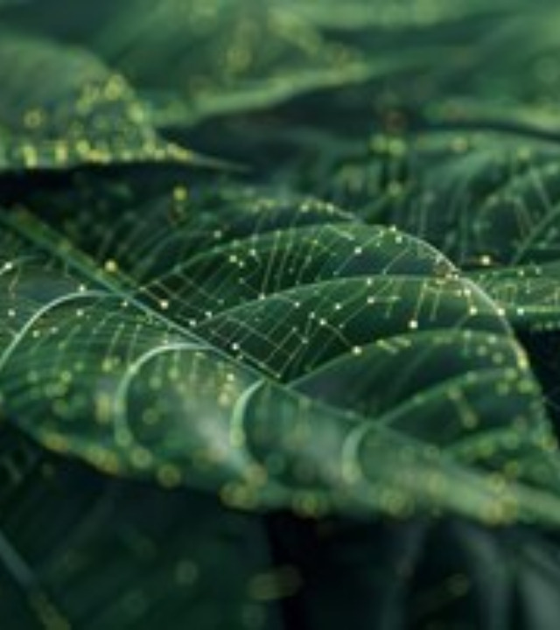
The Road Ahead
Expansion: Support for rare and medicinal plant species.
Localization: Multi-language interface for rural global farmers.
Smart Alerts: Weather-based care advice integrated with local APIs.

Slide 9
References
N. Nigar, A. Jaleel, S. Islam, M. K. Shahzad, and E. A. Affum, "IoMT meets machine learning: From edge to cloud chronic diseases diagnosis system," J. Healthcare Eng., vol. 2023, no. 1, 2023, Art. no.
Z. Li, F. Liu, W. Yang, S. Peng, and J. Zhou, "A survey of convolutional neural networks: Analysis, applications, and prospects," IEEE Trans. Neural Netw. Learn. Syst., vol. 33, no. 12, pp. 6999-7019, Dec. 2022.
M. H. K. Mehedi, A. K. M. S. Hosain, S. Ahmed, S. T. Promita, R. K. Muna, M. Hasan, and M
T. Reza, "Plant leaf disease detection using transfer learning and explainable Al," in Proc. IEEE 13th Annu.
Inf. Technol., Electron. Mobile Commun. Conf. (IEMCON), Oct. 2022
hS. S. Harakannanavar, J. M. Rudagi, V. I. Puranikmath, A.
Siddiqua, and R. Pramodhini, "Plant leaf disease detection using computer vision and machine learning algorithms," Global Transitions Proc., vol. 3,
June 2022

Slide 10
Thank You!
For your attention & time
Abhiroop
Sourav
Sohin
Abhiram

